Slide 1

The Global Digital Divide
An analysis of internet usage across the world

Slide 2
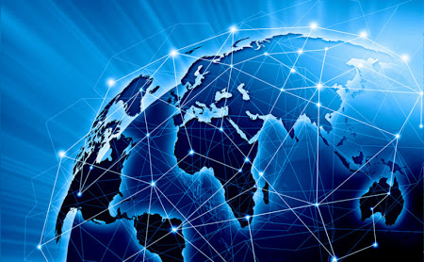
Table of contents
Motivations & Summary
Process summary
Analysis & Findings
Conclusions & Limitations

Slide 3

Visualizations

Slide 4
Visualizations – Global Overview
Map showing Internet population for all countries
Map showing Internet penetration for all countries
Map showing Internet cost for all countries
Map showing Internet speed for all countries
Bar chart with top 10 countries
Bar chart with bottom 10 countries

Slide 6
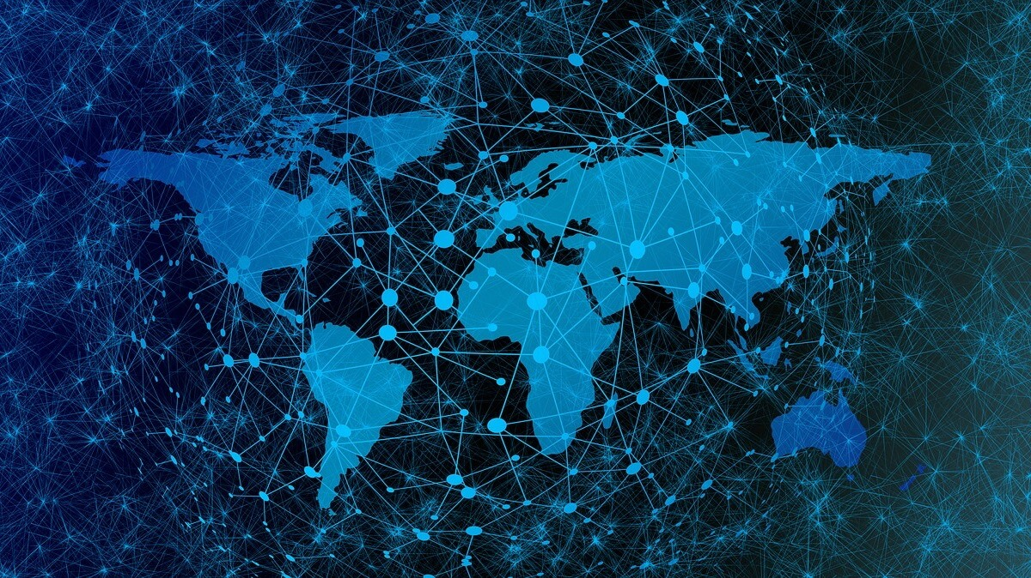

Slide 7



1. Extract
2. Transform (Latyr/Stephen)
3. Load/Analyze (Prajakta)
Pandas
+ Json
(Latyr)
Csv files
(Latyr)
PG Admin
-SQL-
()
6. Web Design (Anna/Lujane)
5. Data Source
4. Flask App(Latyr)
Anna
Flask + SQLAlchemy
(Stephen)

Slide 12


